Slide 1
Cloud Computing

Slide 2
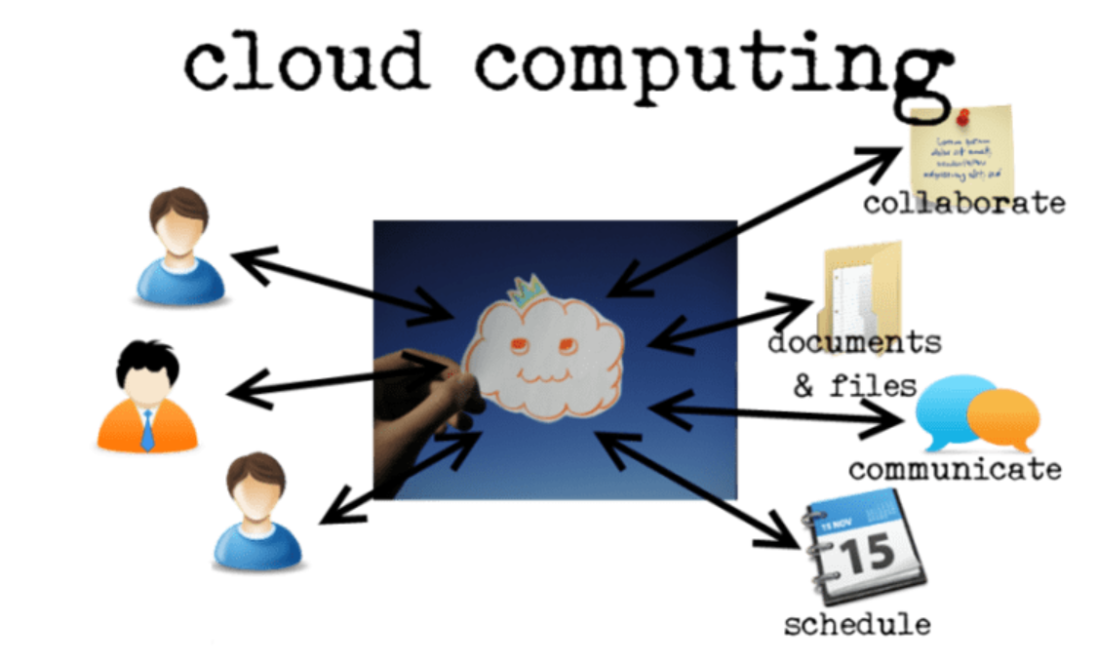

Slide 3
The cloud is a large group of interconnected computers. We usually use the symbol of cloud to denote the complicated networks in circuit. That is why the name cloud computing is given for these network of computers. These computers may be personal or public. Cloud computing extends beyond a single company or enterprise. Access is via internet and it offers massive computing power and storage capability and enables wide scale group collaboration.

Slide 4
Key Properties of Cloud Computing
The key properties of Cloud computing are
User centric : This means once a user is connected to cloud any data there, such as images, videos, applications, becomes his property. Not only the data but the devices connected also becomes his and he can share it with other users.
Task Centric : Cloud computing focus on what one need and how application can do it for us. Here documents are given more priority than the applications which create them.

Slide 5
Powerful : Powerful in the sense that as there is large computers more computing power and mass data storage possible.
Self Healing : Is called Self healing because hot backups are available for every document in the cloud. Hence if one document crashes there will be it's duplicate ready to run.

Slide 6
Multi-tenancy & Intelligence: Multi-tenancy refers to sharing of data and costs across a large pool of users. As various data are stored in cloud data mining and analysis are necessary for accessing information in an intelligent manner.
Programmable : Many processes in cloud computing shall be automate such as backing up crashed data with it's duplicate. Hence programming is associated with cloud computing

Slide 7
Flexible : Flexible as the users may be of different varieties and hence it has to match with their needs.

Slide 8
Benefits From Cloud Computing
Reduces Run time and Response time : As there is large computing capability run time and response time get reduced.
Minimize Infrastructure risk : As there is service providers to provide necessary infrastructure and services infrastructure risk get reduced. We need not purchase infrastructure.

Slide 9
Lower Cost of Entry : For new organizations the infra structure and services can be rented and this reduces their cost of entry into the market.
4. Increased Pace of innovation : As the new and small firms can compete with the leaders in the industry with the help of cloud computing, this increases the pace of innovation.
5. Cost Conscious users are satisfied : Most of the users are cost conscious. They are well satisfied by the services cloud computing provides.

Slide 10
Cloud Computing Services
Amazon web services
Google App Engine

Slide 11
What is AWS? – Amazon Web Services(AWS) is a cloud service from Amazon, which provides services in the form of building blocks, these building blocks can be used to create and deploy any type of application in the cloud.
These services or building blocks are designed to work with each other, and result in applications that are sophisticated and highly scalable.

Slide 12
What are the services provided by AWS?
Each type of service in this “What is AWS” blog, is categorized under a domain, the few domains which are widely used are:
Compute
Storage
Database
Migration
Network and Content Delivery
Management Tools
Security & Identity Compliance
Messaging

Slide 13
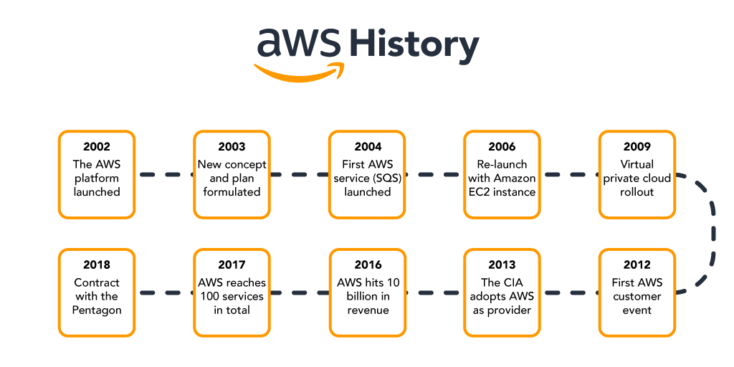

Slide 14
Compute Services
The Compute domain includes services related to compute workloads, it includes the following services:
EC2 (Elastic Compute Cloud)
Lambda
Elastic Beanstalk
Amazon LightSail

Slide 15
Storage Services
The Storage domain includes services related data storage, it includes the following services:
S3 (Simple Storage Service)
Elastic Block Store
Amazon Glacier
AWS Snowball

Slide 16
Database Services
The Database domain is used for database related workloads, it includes the following services:
Amazon Aurora
Amazon RDS
Amazon DynamoDB
Amazon RedShift

Slide 17
Migration Services
Migration Services
The Migration domain is used for transferring data to or from the AWS Infrastructure, it includes the following services:
AWS Database Migration Service
AWS SnowBall
For details, You can even check out the details of Migrating to AWS with the AWS Cloud Migration Certification.

Slide 18
Networking and Content Delivery Services
The Networking and Content Delivery domain is used for isolating your network infrastructure, and content delivery is used for faster delivery of content. It includes the following services:
Amazon Route 53
AWS CloudFront

Slide 19
Management Tools
The Management Tools domain consists of services which are used to manage other services in AWS, it includes the following services:
AWS CloudWatch
AWS CloudFomation
AWS CloudTrail

Slide 20
Security & Identity, Compliance Services
The Security & Identity, Compliance domain consist of services which are used to manage to authenticate and provide security to your AWS resources. It consists of the following services:
AWS IAM
AWS KMS
AWS Shield

Slide 21
Messaging Services
The Messaging domain consists of services which are used for queuing, notifying or emailing messages. It consists of the following domains:
Amazon SQS
Amazon SNS
Amazon SES
Amazon Pinpoint

Slide 22
Advantages of AWS
Easy to use
AWS is made to enable suppliers, ISVs, and application providers to swiftly and securely host your apps, whether they are SaaS-based or not. To access AWS’s application hosting platform, use the AWS Management Console or well-documented web services APIs.

Slide 23
Flexible:
You can choose the web application platform, programming language, operating system, database, and other services you require with AWS. You get a virtual environment through AWS that you may fill with the programs and services your application needs. As a result, existing applications can be more easily migrated while still having alternatives for developing new solutions.

Slide 24
Cost-Effective:
There are no long-term contracts or upfront payments; you simply pay for the computing power, storage, and other resources that you really utilize. Visit the AWS Economics Center for further details on comparing the expenses of other hosting options with those of AWS.

Slide 25
Reliable:
You can benefit from a scalable, reliable, and secure global computing infrastructure with AWS, which serves as the virtual foundation for Amazon.com’s multi-billion dollar online company and has been refined for more than ten years.

Slide 26
Scalable and high-performance:
Your application can scale up or down depending on demand using AWS technologies like Auto Scaling and Elastic Load Balancing. You get immediate access to computation and storage resources thanks to Amazon’s extensive infrastructure.

Slide 27
Secure
Physical, operational, and software safeguards are all used by AWS to secure and harden our infrastructure. The AWS Security Center has more details.

Slide 28
Applications of AWS
Businesses of any size and sector may create complex applications with AWS, from hyper-scale web applications to big data analytical apps. Here are a few of the typical AWS applications:

Slide 29
Storage and backup – For organizations, Amazon’s cloud storage is a convenient and practical offering. It can save important data and gives a variety of storage options based on needs. AWS provides storage, operating essential business applications, file indexing functionality, high-performance writing or reading, and archiving.
Enterprise IT – Amazon cloud services provide the perfect remedy for the cumbersome pace of enterprise IT. AWS makes it possible to build, test, and run auxiliary processes quickly in the cloud. It quickens the project’s launch and gives it an advantage over rivals.

Slide 30
Mobile, Web, and Social Applications – Unlike other cloud services, AWS can create and scale a wide range of applications, including SaaS, mobile, and e-commerce ones. On serverless platforms, new applications can be created without the use of an operating system or other systems. Scalable apps can also be developed on AWS using API-driven programming.
Big Data – AWS’s scalable storage makes it possible to conduct more frequent analytics. It is ideal for creating data lakes or warehouses because it doesn’t take up much space or require much work to index. Together, AWS and Big Data provide the strength and infrastructure required to support sophisticated intelligent applications.

Slide 31
Websites – The AWS cloud can be used to host websites. Additionally, it works well for hosting domains, DNS, and CDNs.
Gaming – Online connectivity and a lot of processing power are needed for gaming applications. AWS makes it simple to access for the global gaming network and offers players the best global online gaming experience.

